Slide 1
The ideas we’ve developed apply to all forms of “light”
For this reason, we call light more generally electromagnetic radiation

Slide 2
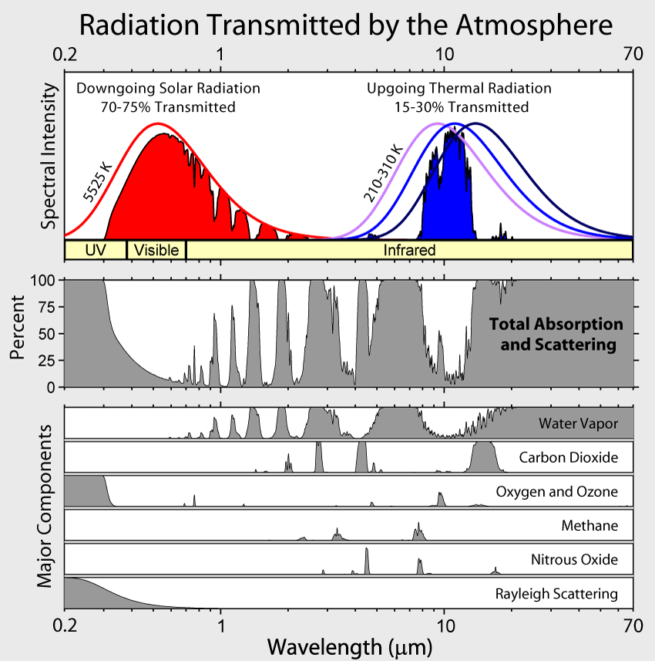



Wavelength ranges for climate scientists: shortwave and longwave
Shortwave light includes uv, visible, and the near-IR.
Longwave includes the parts of the IR called the mid-IR and the far-IR.
3
$$200 nm$$
$$(0.2 μm)$$
$$3000 nm$$
$$(3 μm)$$
$$70,000 nm$$
$$(70 μm)$$

Slide 3
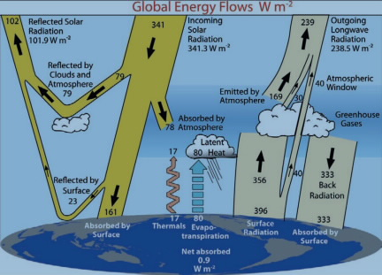
Shortwave part of radiative balance
Shortwave
3
Of the shortwave coming down from the sun, about 30% gets reflected by clouds and the surface (ice/snow), the rest is absorbed by the surface and atmosphere.

Slide 4
Longwave part of radiative balance
Longwave
3
Of the longwave light coming off the surface, most is captured by the atmosphere, then re-emitted back down (“Back Radiation”). That’s the greenhouse effect.

Slide 5
Why we care: Disrupting planetary radiative balance
Shortwave
Longwave
Climate change happens when the planet gets out of radiative balance. How might this happen?
If there’s a change in …
Reflectivity
Absorptivity of the atmosphere
Radiation from the surface
Radiation from the atmosphere
Then we’d expect the temperature of the planet to (go up, go down) …

Slide 6
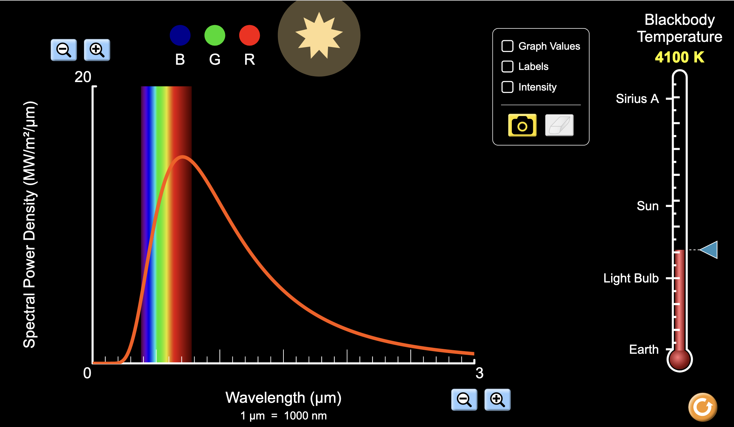
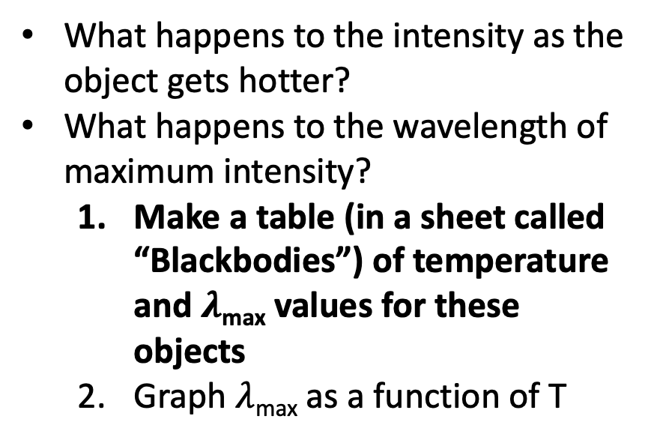
Generating your own Blackbody Spectra
https://phet.colorado.edu/sims/html/blackbody-spectrum/latest/blackbody-spectrum_en.html
What happens to the intensity as the object gets hotter?
What happens to the wavelength of maximum intensity?
Make a table (in a sheet called “Blackbodies”) of temperature and $λ$_{max} values for these objects
Graph $λ$_{max} as a function of T

Slide 7
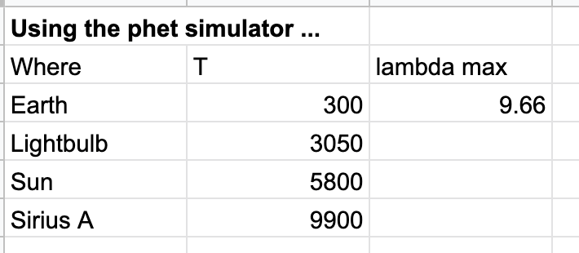
Making a table of temperature and 𝜆_{max}
https://phet.colorado.edu/sims/html/blackbody-spectrum/latest/blackbody-spectrum_en.html

Slide 8
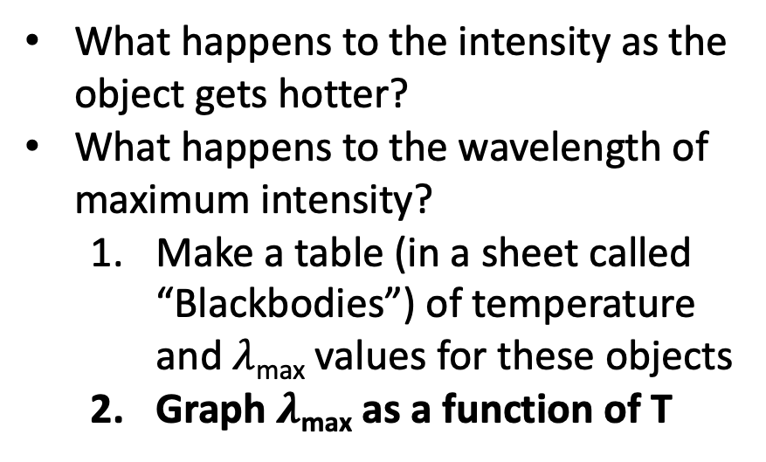
Generating your own Blackbody Spectra
https://phet.colorado.edu/sims/html/blackbody-spectrum/latest/blackbody-spectrum_en.html
What happens to the intensity as the object gets hotter?
What happens to the wavelength of maximum intensity?
Make a table (in a sheet called “Blackbodies”) of temperature and $λ$_{max} values for these objects
Graph $λ$_{max} as a function of T

Slide 9
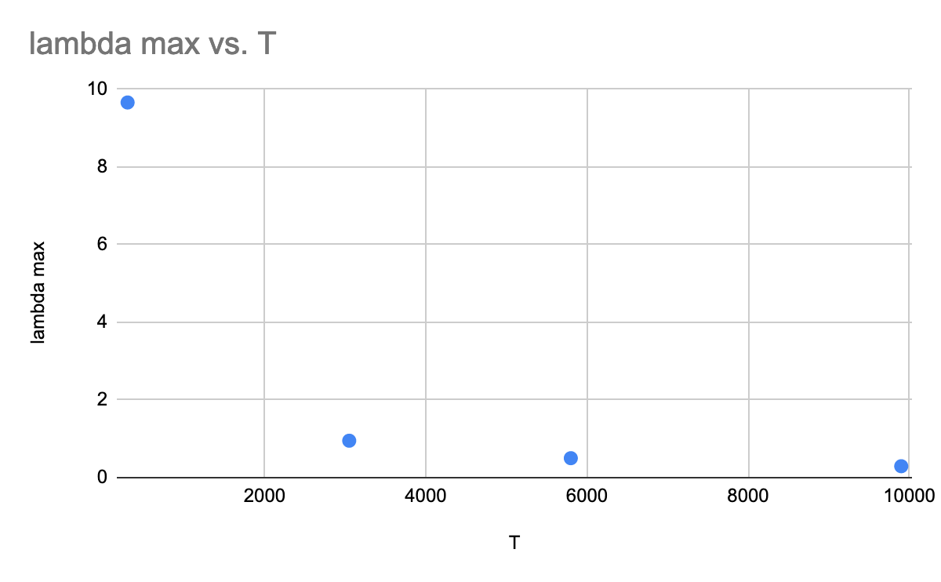

Making a graph of 𝜆_{max} vs temperature
Looks like there’s an inverse relationship between the temperature of the object and its $λ_{max}$

Slide 10
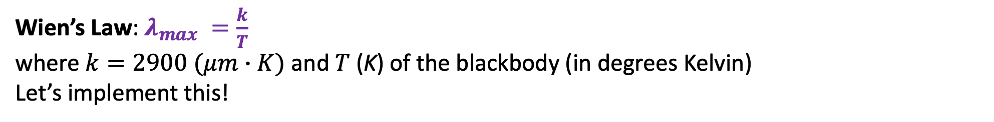
Blackbody Spectra and Wien’s Law
Wien’s Law: $λ_{max} =\frac{k}{T}$
where $k=2900 (μm∙K)$ and $T$(K) of the blackbody (in degrees Kelvin)
Let’s implement this!

Slide 11
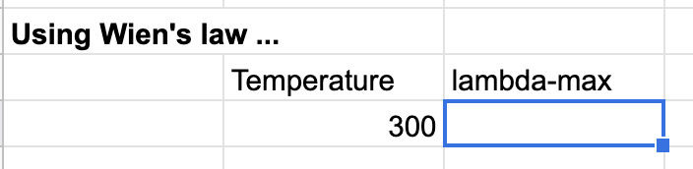

Practicing $λ_{max}=\frac{k}{T}$

Slide 12
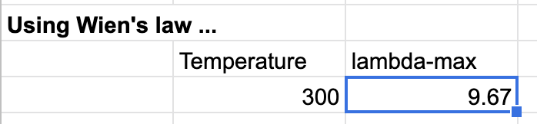

Practicing $λ_{max}=\frac{k}{T}$ … did you results match the simulator?

Slide 13

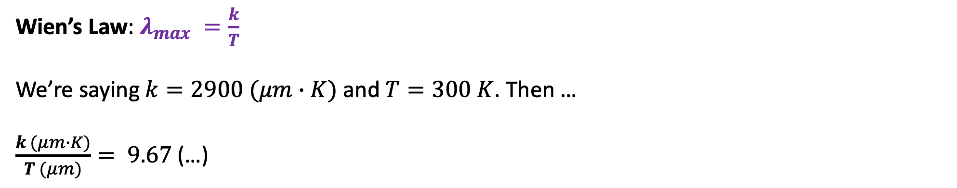
Practicing $λ_{max}=\frac{k}{T}$ … Double-checking the units
Wien’s Law: $λ_{max} =\frac{k}{T}$
We’re saying $k=2900 (μm∙K)$ and $T=300 K$. Then …
$\frac{k (μm∙K)}{T (μm)}= 9.67$(…)

Slide 14
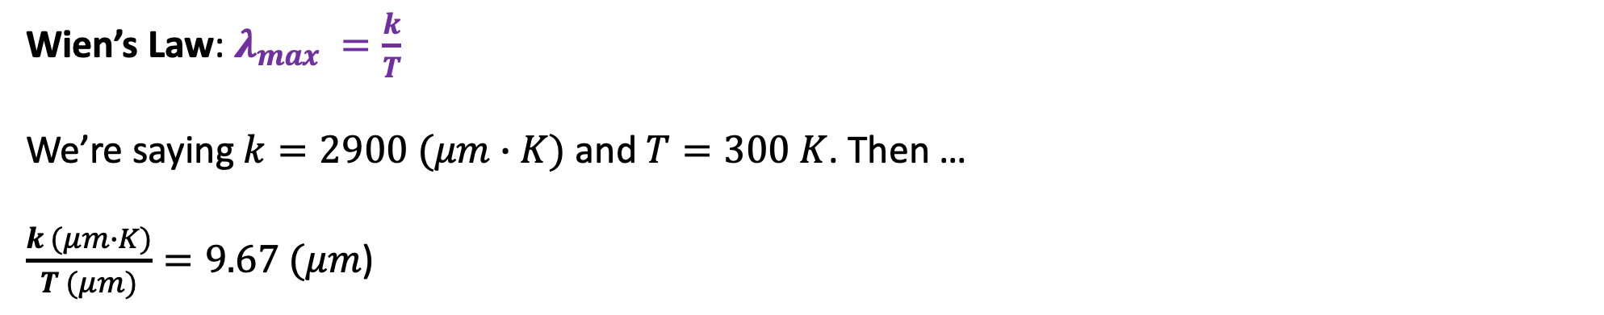
Practicing $λ_{max}=\frac{k}{T}$ … Double-checking the units
Wien’s Law: $λ_{max} =\frac{k}{T}$
We’re saying $k=2900 (μm∙K)$ and $T=300 K$. Then …
$\frac{k (μm∙K)}{T (μm)}=9.67 (μm$)

